Slide 1
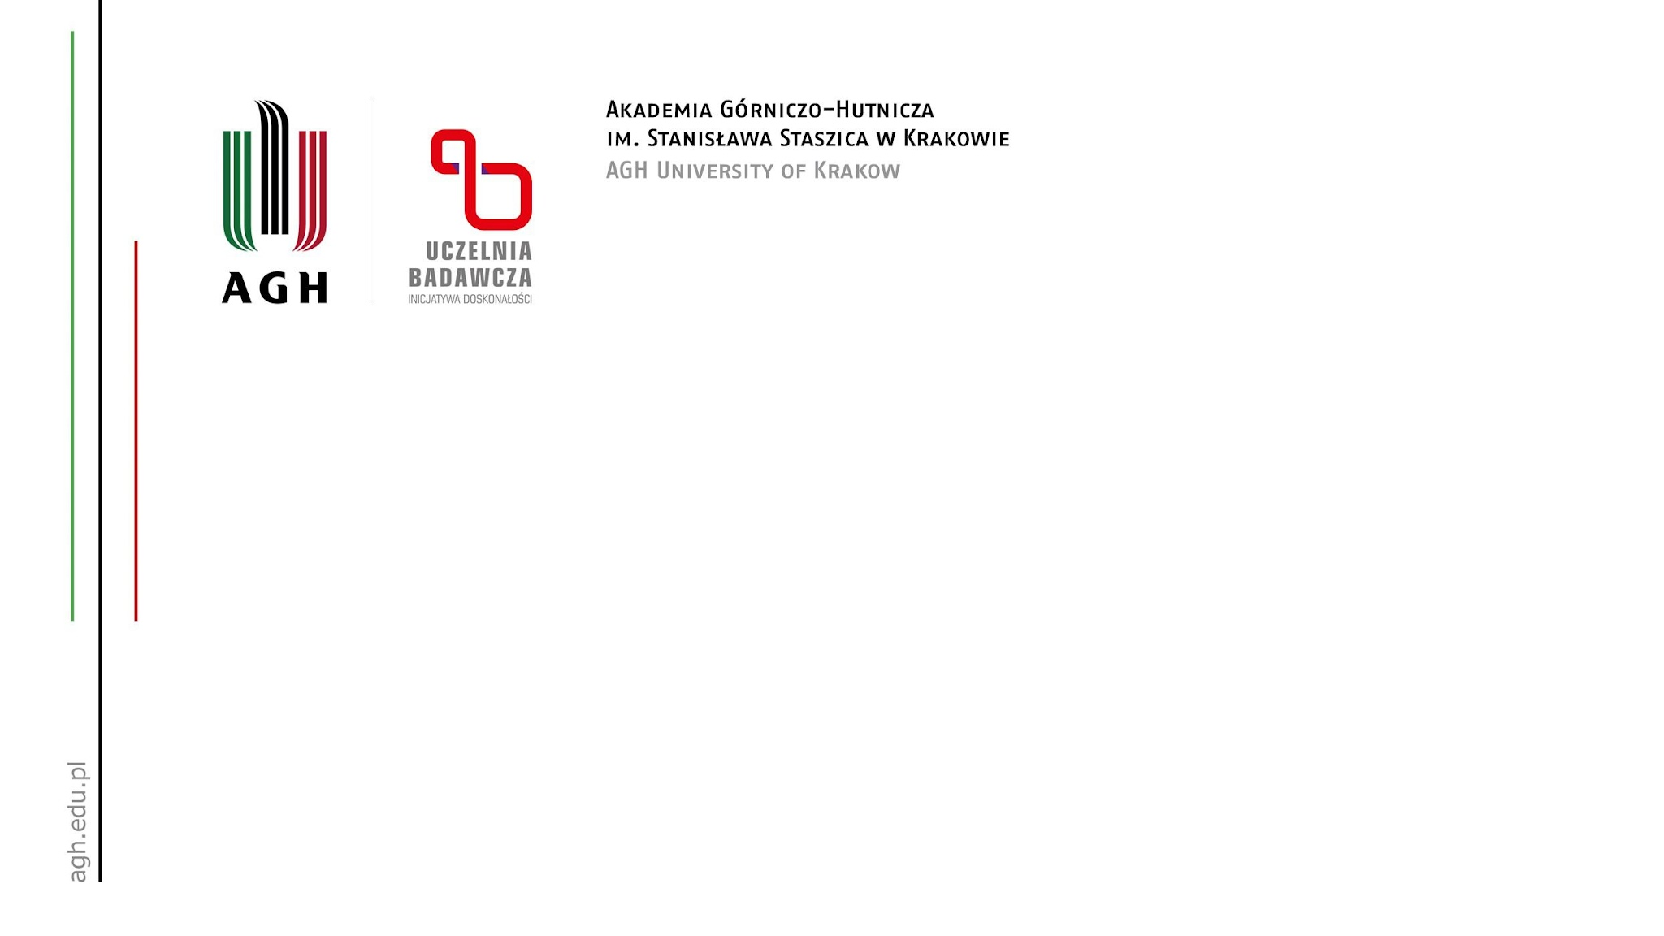
Analysis of the Family of Priceable Committees
Analiza rodziny komitetów wycenialnych
Autor: Hieronim Koc
Opiekun: prof. dr hab. inż. Piotr Faliszewski

Slide 2
Fair division of public money
Participatory budgeting: cities let residents vote how to spend real public money
Core problem: pick a fair set of projects / a fair committee
"Fair" needs a principled definition (like Priceability :))
Theory + experiments

